Slide 1

ARTIFICIAL INTELLIGENCE & MACHINE LEARNING
SESSION NO :29 Part - 1

Slide 2

2.Bagging Explained Delving into Bootstrap Aggregating and its benefits.
Agenda
1. What is Ensemble Learning?
Understanding the core concept of combining multiple models.
3.Random Forests Demystified
Exploring the evolution of Bagging with feature randomness.

Slide 3


What is Ensemble Learning?
Ensemble learning is a machine learning paradigm where multiple models (often called "weak learners") are trained to solve the same problem and combined to get better performance.
The core idea is that by combining the predictions of several models, the overall accuracy and robustness can be significantly improved compared to any single model.
Think of it like a committee making a decision rather than an individual

Slide 4
What is Ensemble Learning?
An ensemble method is a technique which uses multiple independent similar or different models/weak learners to derive an output or make some predictions..
The ensemble methods in machine learning combine the insights obtained from multiple learning models to facilitate accurate and improved decisions.
Ensemble learning techniques is used to improve the accuracy, and performance of machine learning models.
An ensemble can also be built with a combination of different models like Decision Trees, Neural Networks, SVM, Linear regression etc.
Ensemble learning combines the mapping functions learned by different classifiers to generate an aggregated mapping function.

Slide 5
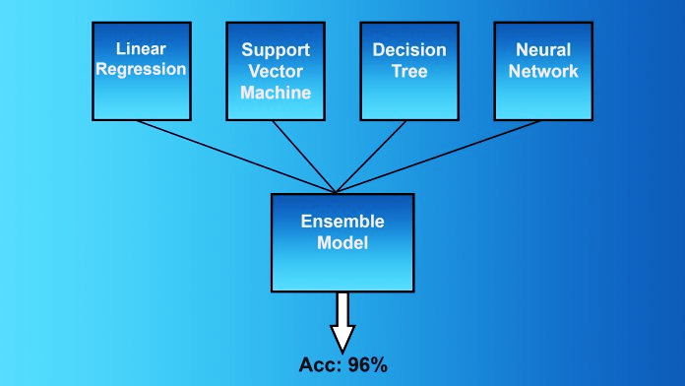
What is Ensemble Learning?

Slide 6
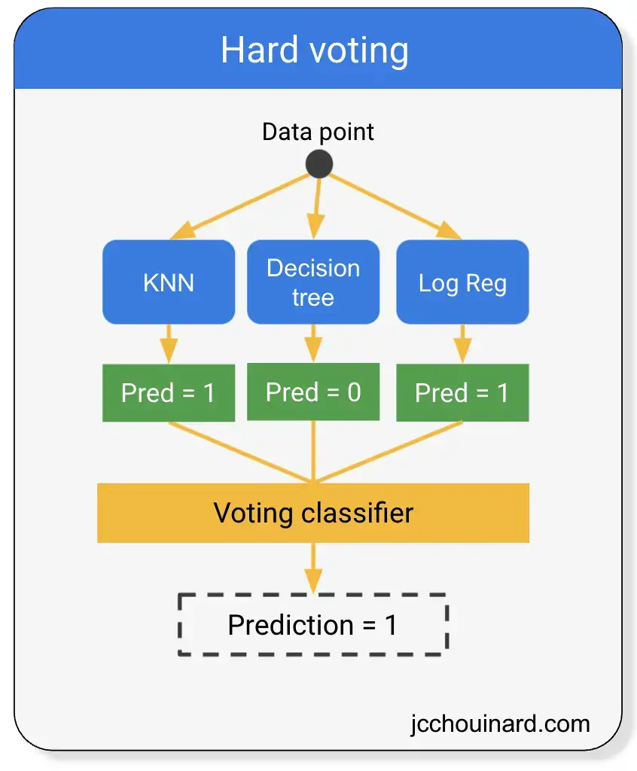
What is Ensemble Learning?

Slide 7
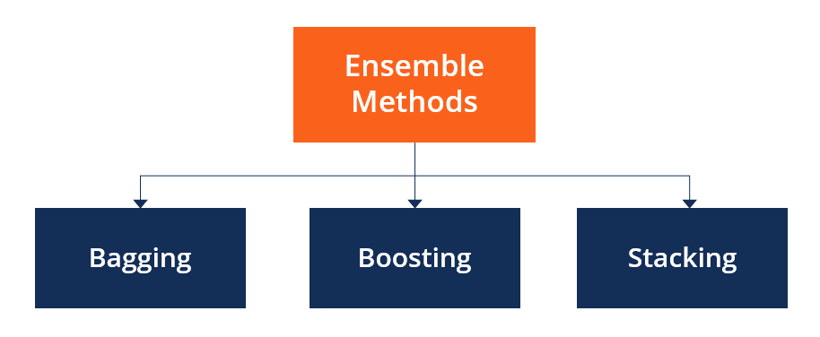
Types of Ensemble Methods:
Bagging: Build models independently on random subsets of data
Boosting: Build models sequentially to correct predecessor errors
Stacking: Combine different types of models

Slide 8
What is Bagging (Bootstrap Aggregating)?
Bagging, also known as bootstrap aggregation, is the ensemble learning method that is commonly used to improve the performance within a noisy dataset.
Bagging of data and is used for both regression and classification models.
It is a homogeneous weak learners’ model that learns from each other independently in parallel and combines them for determining the model average.
Bootstrapping is a sampling technique where samples are derived from the whole population (set).
It improves the model’s accuracy.

Slide 9
How Bagging Works
Take random samples from training data with replacement
Train a model on each sample
Predict using each model
Aggregate predictions
Classification: majority vote
Regression: average predictions

Slide 10
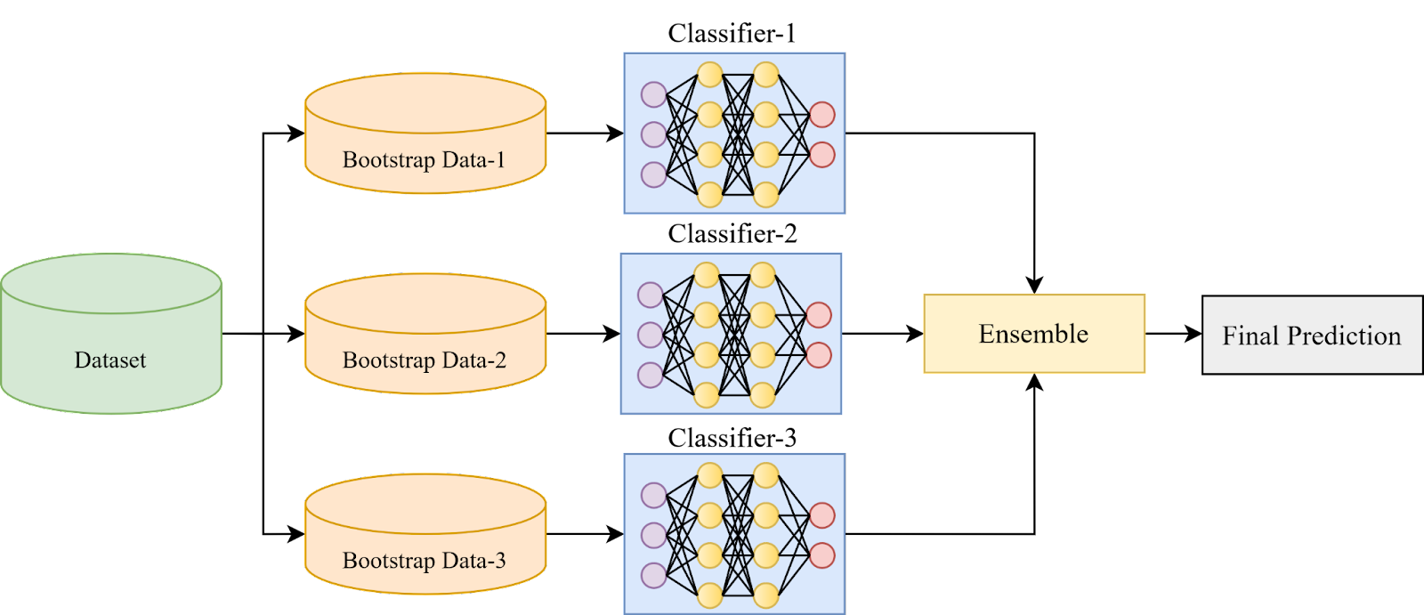
How Bagging Works

Slide 11
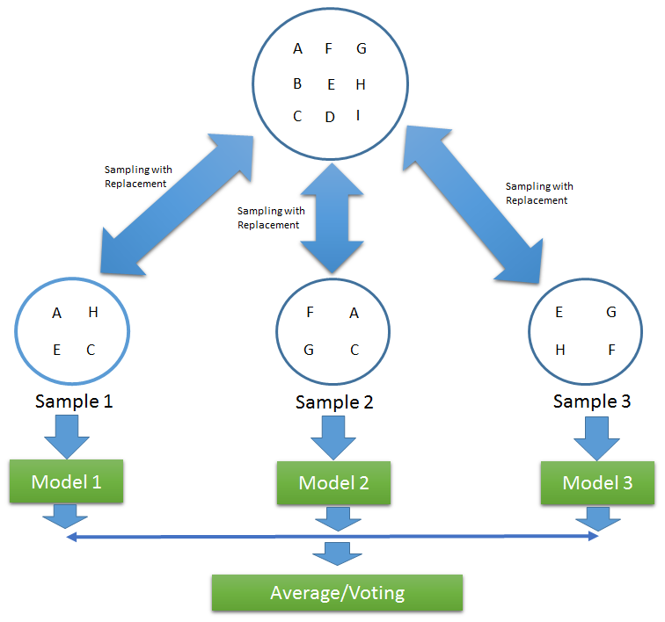
How Bagging Works

Slide 12
What are Random Forests?
Random Forests are a powerful extension of Bagging, specifically designed for decision trees. They introduce an additional layer of randomness to further enhance model performance.
Extension of Bagging: Builds upon the core principles of Bagging.
Additional Randomness: Introduces randomness during the tree construction process.
Feature Sub setting: At each split, only a random subset of features is considered.
De correlated Trees: This process significantly de correlates the individual trees.
Variance Reduction: Further reduces variance, leading to more robust models.
Diverse Forest: Creates a "forest" of diverse and deep decision trees.

Slide 13
Why Use Bagging & Random Forests?
High Accuracy
Often outperform single models by 10-20% or more, providing superior predictive power.
Reduced Overfitting
Averaging or voting smooths out individual model errors, leading to more generalized and stable predictions.
Robustness
Handle noisy data, outliers, and missing values effectively, making them reliable in real-world scenarios.
Feature Importance
Random Forests provide valuable insights into the most relevant features influencing predictions
Scalability
Can be parallelized for faster training, making them efficient for large datasets.

Slide 14
How Random Forest Works
Create bootstrap samples
Build multiple decision trees
At each split, pick a random subset of features
Aggregate predictions via majority vote (classification) or average (regression)
Advantage: Trees become less correlated → better performance

Slide 15
How Random Forest Works
Random Forest is a machine learning algorithm that uses many decision trees to make better predictions.
Each tree looks at different random parts of the data and their results are combined by voting for classification or averaging for regression which makes it as ensemble learning technique.
This helps in improving accuracy and reducing errors.

Slide 16
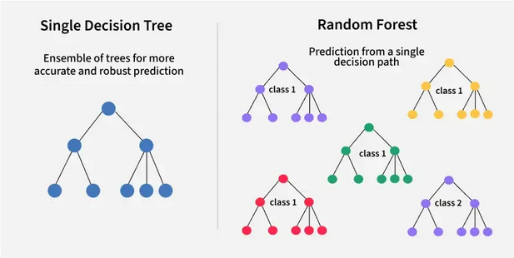
How Random Forest Works

Slide 17
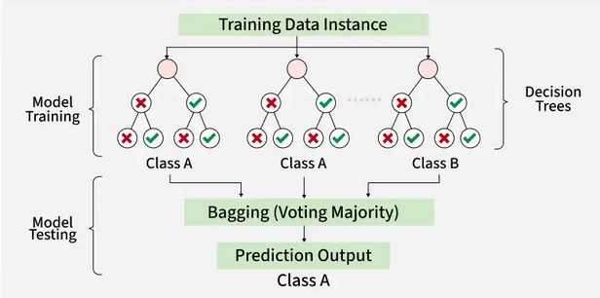
How Random Forest Works

Slide 18





Where are They Used? Practical Applications
Bagging and Random Forests are extensively applied across various industries.
Healthcare Disease: prediction (e.g., cancer diagnosis with 90%+ accuracy), drug discovery, and patient outcome prediction.
Finance Fraud:
detection (e.g., credit card fraud, identifying 95% of fraudulent transactions), and stock market prediction.
E-commerce
Recommendation systems (e.g., predicting user preferences with 85% precision), and customer churn prediction.
Image Recognition
Facial recognition, object detection in autonomous vehicles, and medical image analysis.
NLP
Sentiment analysis, spam detection (e.g., 99% accuracy in blocking spam), and language translation.

Slide 19
Example
Consider a dataset with 5 records:
Applicant | Income | Credit Score | Approved
A | 50K | 700 | Yes
B | 60K | 650 | Yes
C | 45K | 600 | No
D | 80K | 720 | Yes
E | 30K | 580 | No
Bagging creates 3 random samples and builds 3 trees:
Tree 1 predicts: Yes
Tree 2 predicts: No
Tree 3 predicts: Yes
Final Prediction (majority vote): Yes

Slide 20
Bagging
Boosting is an ensemble modeling technique that attempts to build a strong classifier from the number of weak classifiers.
It is done by building a model by using weak models in sequential.
Firstly, a model is built from the training data. Then the second model is built which tries to correct the errors present in the first model. This procedure is continued and models are added until either the complete training data set is predicted correctly or the maximum number of models are added.
Boosting is a method used in machine learning to reduce errors in predictive data analysis.
Boosting is an ensemble learning method that combines a set of weak learners into a strong learner to minimize training errors.

Slide 21
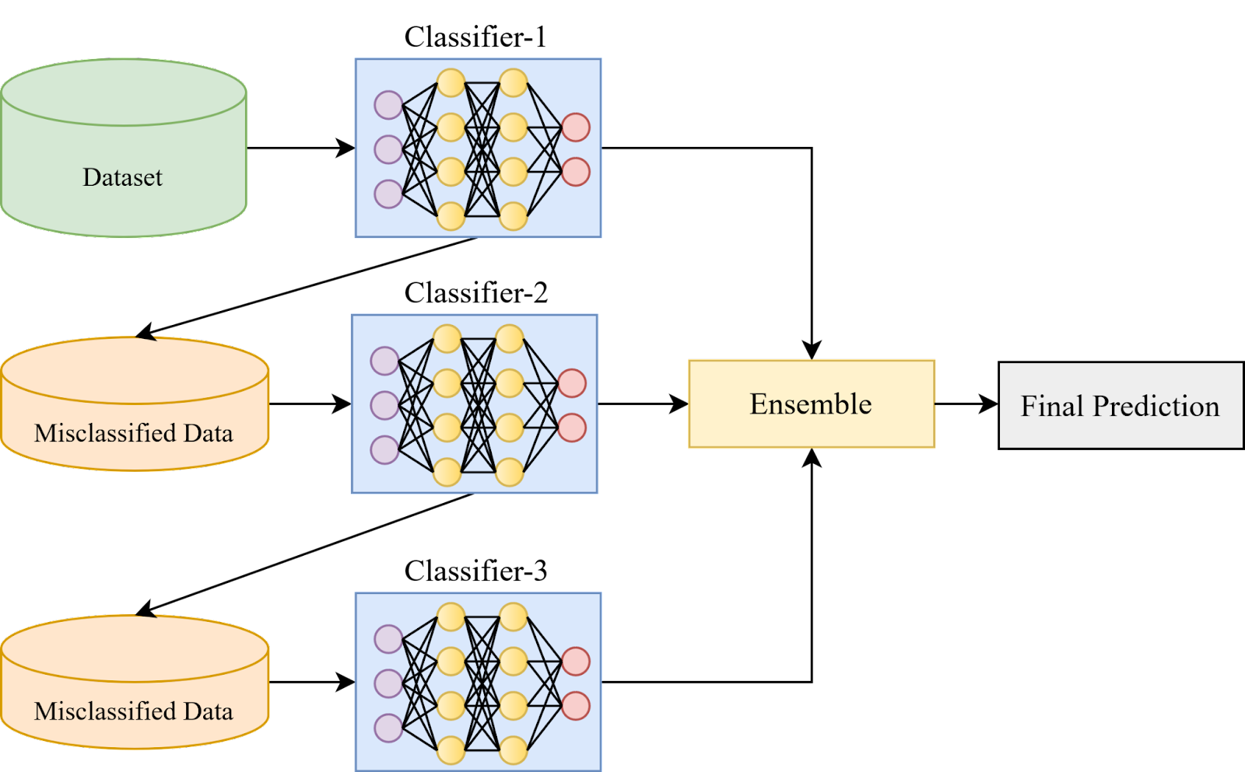
Bagging

Slide 22
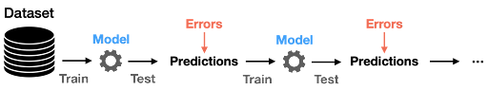
ADAPTIVE BOOSTING (ADABOOST): This is an ensemble of algorithms, where we build models on the top of several weak

Slide 23
Stacking
Stacking is a process of learning how to create such a stronger model from all weak learners’ predictions.
Stacking is similar to boosting models they produce more robust predictors.
Blending is similar to the stacking approach, except the final model is learning the validation and testing data set along with predictions.

Slide 24
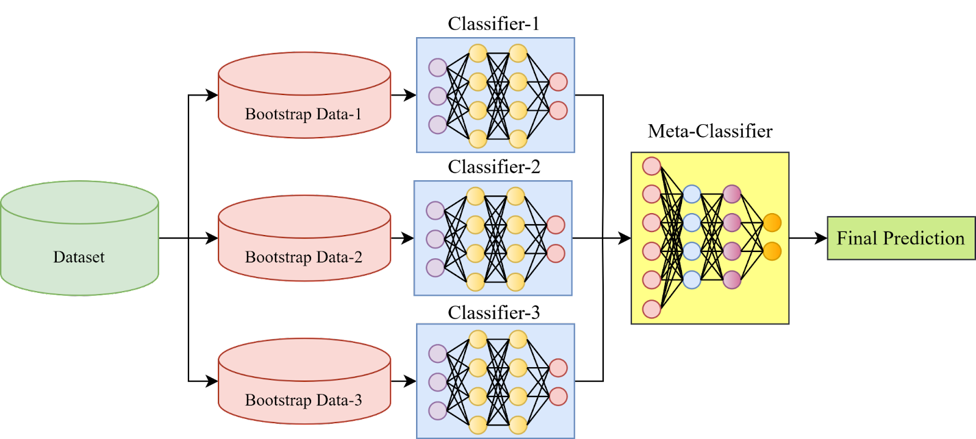
Stacking

Slide 25
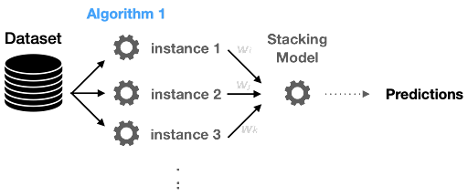
Stacking

Slide 26
Conclusion
An ensemble method is a technique which uses multiple independent similar or different models/weak learners to derive an output or make some predictions
Bagging, also known as bootstrap aggregation, is the ensemble learning method that is commonly used to improve the performance within a noisy dataset.
Boosting is an ensemble modeling technique that attempts to build a strong classifier from the number of weak classifiers.
Stacking is a process of learning how to create such a stronger model from all weak learners’ predictions.

